Slide 1
Changes to standards September 2024 Interactive briefing
Navigate using the arrows buttons
Return to main menu by clicking the home icon
This icon links to online content
Click this icon to exit the presentation
This icon will be displayed when slide have audio
View in slideshow mode for live links

Slide 2
Changes in the September 2024 standards update
Deviations granted against standards
September – December 2024
Draft standards scheduled to be published in December 2024
Draft standards scheduled for consultation
Click a button to proceed

Slide 3
Changes in the September 2024 standards update
Plant
Rolling stock
Data, Systems, and Telematics
No standard updates
1 standard updated
No standard updates
Control, Command, and Signalling
Non-RSSB standards
Infrastructure
3 standards updated
1 point release
3 standards updated
Energy
Rail-related legislation
Operations
2 new standards
Multiple Rule Books updated
No standard updates
No updates
Click the icons with red rings for detail on those changes

Slide 4
Changes to standards – September 2024
One Infrastructure standard has been updated with a point release in the September 2024 Standards Catalogue.
GCGN5612 Issue 2.1 – Rail Traffic Loading Requirements for the Design of Railway Structures The equation in A.1.8 has been corrected.
Click on link icon to go to the standard

Slide 5
Changes to standards – September 2024
One Rolling Stock standard has been updated in the September 2024 Standards Catalogue.
GMGN2694 Issue 1 – Rolling Stock Subsystems and Electromagnetic Compatibility with CCS Subsystems
Click on a play button to find out more about the change.

Slide 6
Changes to standards – September 2024
GMGN2694 Issue 1 – Rolling Stock Subsystems and Electromagnetic Compatibility with
CCS Subsystems
Overview – GMGN2694 Issue 1 gives a methodology with an objective to achieve close EMC between rolling stock and CCS subsystems before route compatibility assessments taking place. The guidance note also gives explanations and the electromagnetic susceptibility limits of a range of CCS subsystems such as for EBI track 200 track circuits. Also, for other types of electromagnetic coupling which can be used in conjunction with the BS EN 50121 series standards that set out requirements and guidance for rolling stock and CCS subsystem EMC.
Benefits – GMGN2694 Issue 1 supports rolling stock designers, suppliers, operators and maintainers in
manufacturing rolling stock that has close EMC from the outset to CCS subsystems. It reduces
the time taken to perform physical EMC testing as set out in RIS-8270-RST.
Audience – This document is intended to be used by:
• Rolling stock designers • Rolling stock manufacturers • Train operating companies (TOC)
• Freight operating companies (FOC) • Rolling stock owning companies (ROSCO)
• Infrastructure managers • Rolling stock and CCS system supplier
RU
Builders
Suppliers
Assessment bodies
Designers
IM
Click on the link icon to go to the standard

Slide 7
Changes to Standards – September 2024
Three Control, Command and Signalling standards have been updated in the September 2024 Standards Catalogue.
RIS-0733-CCS – Issue 1.1 – Lineside Operational Signs
RIS-0734-CCS – Issue 2.1 – Signing of Permissible Speeds
RIS-0735-CCS – Issue 1.1 – Signing of Temporary and Emergency Speed Restrictions
Click play to find out more about the change

Slide 8
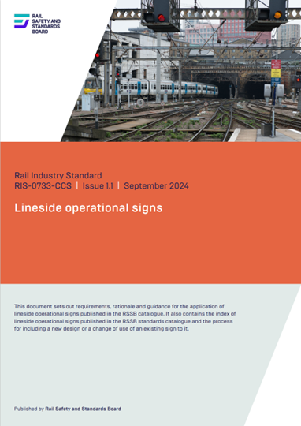
Changes to Standards – September 2024
RIS-0733-CCS – Issue 1.1 – Lineside Operational Signs
Overview – RIS-0733-CCS Issue 1.1 provides updates to the appendices for introduction of new PSR and TSR signs AD06 and AF09, applicable to front of train acceleration. Other amendments have been made to existing sign descriptions. ETCS location marker AB10 has now been added to appendix A.4.1. References to EU Technical Specifications for Interoperability (TSIs) have been updated to GB National Technical Specification Notices.
Benefits – This forms part of a suite of standards changes relating to the introduction of new acceleration indicators applicable to Permanent Speed Indicators and the termination of Temporary and Emergency speed restrictions.
The overall benefit of the change is estimated at approximately £41M over 5 years.
Audience – RIS-0733-CCS Issue 1.1 is for:
Infrastructure managers, project entities who develop and design signalling
systems, railway undertakings.
RU
IM
Project Entities
They are: RIS-0733-CCS Issue 1.1, RIS-0734-CCS Issue 2.1 Signing of Permissible Speeds, RIS-0735-CCS Issue 1.1 Signing of Temporary and Emergency Speed Restrictions, GERT8000-SP Issue 7 Speeds, GERT8000-TW7 Issue 10 Wrong Direction Movements and RS521 Issue 7 Signals, Handsignals, Indicators and Signs Handbook.
Click the link icon to go to the standard

Slide 9
Changes to Standards – September 2024
RIS-0734-CCS – Issue 2.1 – Signing of Permissible Speeds
Overview – RIS-0734-CCS Issue 2.1 provides new requirements, rationale, and guidance for use of acceleration indicators in conjunction with permissible speed indicators. Other changes have been made to provide an additional requirement and guidance to section 3.1. This is to clarify the provision of permissible speed warning indicators when applied within sequenced speed reductions.
Benefits – This forms part of a suite of standards changes relating to the introduction of new acceleration indicators applicable to permanent speed indicators and the termination of temporary speed restrictions. The overall benefit of the changes is estimated at approximately £41M over 5 years.
They are: RIS-0733-CCS Issue 1.1 Lineside Operational Signs, RIS-0734-CCS Issue 2.1, RIS0735-CCS Issue 1.1 Signing of Temporary and Emergency Speed Restrictions, GERT8000-SP Issue 7 Speeds, GERT8000-TW7 Issue 10 Wrong Direction Movements and RS521 Issue 7 Signals, Handsignals, Indicators and Signs Handbook.
Audience – RIS-0734-CCS Issue 2.1 is for:
Infrastructure managers
Project entities who develop and design signalling systems
Railway undertakings.
RU
IM
Project Entities
Click the link icon to go to the standard

Slide 10
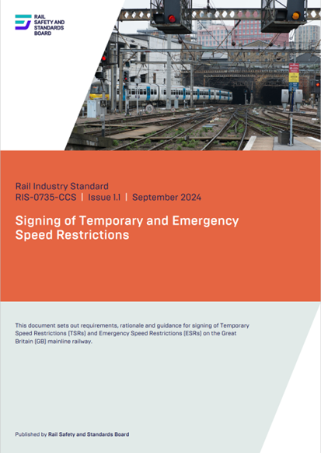
Changes to Standards – September 2024
RIS-0735-CCS – Issue 1.1 – Signing of Temporary and Emergency Speed Restrictions
Overview – RIS-0735-CCS Issue 1.1 provides new requirements and guidance for use of acceleration indicators in conjunction with the termination of temporary speed restrictions. A change has been made to clarify Figure 13 for TSR warning board position at a diverging junction.
Benefits – This forms part of a suite of standards changes relating to the introduction of new acceleration indicators applicable to permanent speed indicators and the termination of temporary speed restrictions. The overall benefit of the change is estimated at approximately £41M over 5 years.
They are: RIS-0733-CCS Issue 1.1 Lineside Operational Signs, RIS-0734-CCS
Issue 2.1 Signing of Permissible Speeds, RIS-0735-CCS Issue 1.1, GERT8000-SP
Issue 7 Speeds, GERT8000-TW7 Issue 10 Wrong Direction Movements and
RS521 Issue 7 Signals, Handsignals, Indicators and Signs Handbook.
Audience – RIS-0735-CCS Issue 1.1 is for:
• Infrastructure managers
• Project entities who develop and design signalling systems
• Railway undertakings.
RU
IM
Project Entities
Click the link icon to go to the standard

Slide 11
Changes to Standards – September 2024
Two new Traffic Operation and Management standards have been published in the September 2024 Standards Catalogue.
RIS-3771-TOM Issue 1 – Operation of Route and Line Proving Trains
TN3300 Issue 1 – Clarification on drugs and Alcohol testing for safety-critical workers.
Click play to find out more about the change
Rule Book updates

Slide 12
Changes to Standards – September 2024
The following Rule Book Modules and Handbooks have been updated in the September 2024 standards catalogue
GERT8000-HB1 Handbook 1
GERT8000-HB6 Handbook 6
GERT8000-HB7 Handbook 7
GERT8000-HB8 Handbook 8
GERT8000-HB11 Handbook 11
GERT8000-HB12 Handbook 12
GERT8000-HB15 Handbook 15
GERT8000- Module OTM
GERT8000- Module SP
GERT8000- Module SS2
GERT8000-
Module S5
GERT8000- Module T3
GERT8000- Module TS1
GERT8000- Module TS9
GERT8000- Module TS11
GERT8000- Module TW1
GERT8000- Module TW5
GERT8000-
Module TW7
GERT8000- Module TW8
RS521 Signals & Signs Handbook
Click play to find out more about the change

Slide 13
Changes to Standards – September 2024
RIS-3771-TOM Issue 1 – Operation of Route- and Line-Proving Trains
Overview – This standard sets out requirements and guidance for operators to establish a well-defined process for collaborative decision-making on the operation of route- and line-proving trains. It provides the necessary guidance on which trains are most appropriate and what relevant staff to mobilise. It also enables infrastructure managers to provide competent staff for tasks such as clearing debris and inspecting assets.
Benefits – A common approach for route and line proving will allow for more consistency and better collaboration among operators. Carrying out route proving after extreme weather can reduce delays and save costs. Enabling line proving minimises delays caused by possession overruns or related issues. Allowing line-proving trains during closure can help prevent disruptions to scheduled train services.
A standard route- and line-proving process with clear instructions and guidance to operational staff can help to reduce any misunderstanding that could result in workforce injury. It is estimated that this could save the industry a potential of around £6.3m over five years.
Audience – The standard is designed for transport operators involved in developing operating procedures for route-and line-proving trains.
RU
IM
Click the link icon to go to the standard

Slide 14
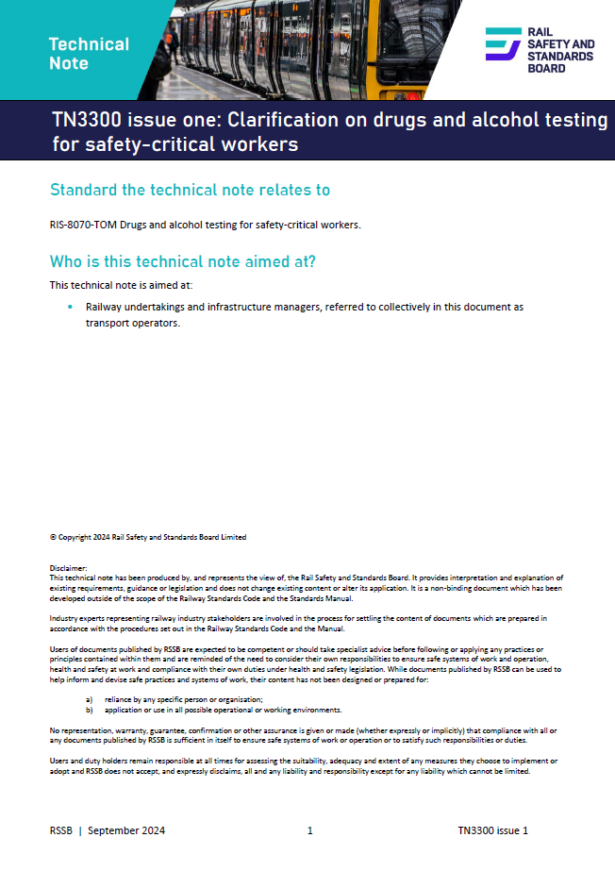
Changes to Standards – September 2024
TN3300 Issue 1 – Clarification on drugs and alcohol testing for safety-critical workers
Overview – This technical note relates to RIS-8070-TOM Drugs and alcohol testing for safety-critical workers. RSSB recognises there is a lack of consistency, and confusion within the industry, on the processes for drugs and alcohol testing. This technical note sets out the rationale for the requirement and the importance of undertaking the tests. It covers:
random testing
testing following an incident or accident
testing methods and facilities
help for those who declare a problem with drugs or alcohol.
Audience – Railway undertakings and infrastructure managers
RU
IM
Click the link icon to go to the standard

Slide 15
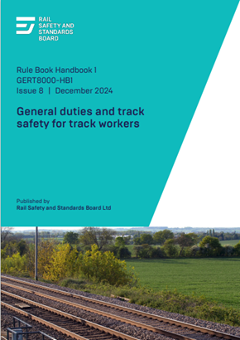
Changes to standards – September 2024
GERT8000-HB1 Issue 8 – General duties and track safety for track workers (1 of 2)
A new section has been added to this module. It outlines the actions for staff to take when travelling on a route-proving train. Following recommendations from the Rail Accident Investigation Branch into the Carmont accident, a new standardised approach to route proving has been developed. The Rule Book has been updated with instructions for staff who are required to access the track from a route-proving train.
The rules concerning holders of handbooks 1, 6, and 7 going on or near the line— either alone or as part of a group—were too general. They did not take into account varying degrees of competency. They have been extensively revised
with these objectives:
To provide a clear definition of when walking on or near the line is permitted and for what reasons.
To define the extent to which walking on or near the line is permitted for varying levels of competency.
To define the permitted arrangements for crossing lines open to traffic when walking. (Continued on next slide.)
RU
IM
Suppliers
Click the link icon to go to the standard

Slide 16
Changes to standards – September 2024
GERT8000-HB1 Issue 8 – General duties and track safety for track workers (2 of 2)
This handbook explains that going on or near the line alone is only permitted for:
a controller of site safety (COSS) or individual working alone (IWA) when carrying out work, or walking to or from a site of work
for someone other than a COSS or IWA who has to join or leave a group, and must do so under the instructions of a COSS
or someone other than a COSS or IWA who is allowed to go on or near the line under a method of working shown in company instructions.
To go on or near the line with others, a COSS must be present who has given a briefing on the safe system of work that will apply. Instructions are included on moving around unexpected obstacles and crossing lines open to traffic.
Section 2.3 allows getting off a moving rail vehicle if it is one designed for continuous slow-speed movement. Modifications to some vehicles of this type are being carried out with the intention that they could be boarded while moving. This section has been changed to allow staff to get on and off this type of vehicle. The competency of safe work leader (SWL) is no longer a recognised one and all reference to this obsolete competency has been removed.
RU
IM
Suppliers
Click the link icon to go to the standard

Slide 17
Changes to standards – September 2024
GERT8000-HB6 Issue 8 – General duties of an individual working alone (IWA)
This handbook did not contain any rules concerning an IWA when walking to or from a site of work. These have now been included. An IWA is only permitted to walk on or near the line to get to or return from a site of work and then only if:
the IWA has blocked the open line
someone else has blocked the line and the IWA has agreed a safe system of work with that person
the IWA is carrying out an alternative arrangement shown in a safe work pack or company instructions.
An IWA is allowed to place possession protection providing the person in charge of the possession (PICOP) has given an assurance that the protecting signal for the line concerned has been placed to danger. To cater for the corresponding situation on an ERTMS line, a reference has been added to the route being closed.
The competency of safe work leader (SWL) is no longer a recognised one. All references to a safe work leader have been removed from the handbook.
RU
IM
Suppliers
Click on the link icon to go to the standard

Slide 18
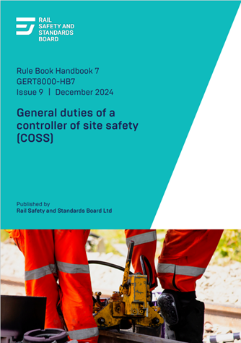
Changes to standards – September 2024
GERT8000-HB7 Issue 9 – General duties of a controller of site safety (COSS) (1 of 2)
This handbook did not contain any rules concerning a COSS walking alone to or from a site of work. These have now been included. A COSS is only permitted to walk on or near the line alone in order to get to or return from a site of work and then only if:
the COSS has blocked the line
someone else has blocked the line and the COSS has agreed a safe system of work with that person
the COSS is carrying out an alternative arrangement shown in the safe work pack or in company instructions.
A new Section 5 has been introduced on walking with a group to or from a site of work, or between sites of work. In this situation the COSS must set up a safe system of work that would apply when walking with a group, or an alternative arrangement shown in the safe work pack. However, site wardens cannot be used as a safe system of work. The use of lookouts requires to be authorised. This section also includes arrangements if anyone has to join, leave or rejoin the group. (Continued on next slide.)
RU
IM
Suppliers
Click on the link icon to go to the standard

Slide 19
Changes to standards – September 2024
GERT8000-HB7 Issue 9 – General duties of a controller of site safety (COSS) (2 of 2)
Noise from work that is being carried out can prevent any member of a group from hearing any warning that is given when the safe system of work in use is either equipment or lookout warning. A new instruction has been included to say that the COSS must not use equipment or lookout warning if this would be the case.
The competency of safe work leader (SWL) is no longer a recognised one. All references to a safe work leader have been removed from the handbook.
RU
IM
Suppliers
Click on the link icon to go to the standard

Slide 20
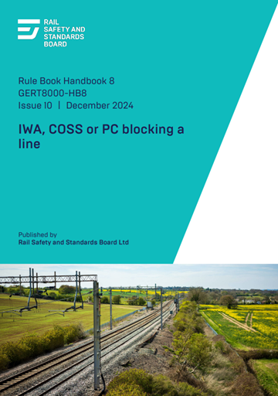
Changes to standards – September 2024
GERT8000-HB8 Issue 10 – IWA, COSS, or PC blocking a line
A new section has been added to this module outlining the actions of a COSS when travelling on a route-proving train. Following recommendations from the Rail Accident Investigation Branch into the Carmont accident, a new standardised approach to route proving has been developed. As part of this project, the Rule Book has been updated with instructions telling staff what to do if they are required to access the track from a route-proving train.
Aiming to use new technology to better protect staff working on the railway, equipment has been the subject of successful trials which allows a COSS to disconnect signalling equipment remotely providing
additional protection for a line blockage. The handbook has been changed to include this as a further permitted means of providing additional protection.
The competency of safe work leader (SWL) is no longer recognised. All reference to this obsolete competency has been removed.
RU
IM
Suppliers
Click on the link icon to go to the standard

Slide 21
Changes to standards – September 2024
GERT8000-HB11 Issue 11 – Duties of the person in charge of the possession (PICOP) (1 of 2)
This module has been updated following the RAIB investigation into a 'near miss' with possession support staff. It relates to the arrangements for granting possessions in signal boxes and control centres with multiple workstations which should be reviewed and, where appropriate, improved.
The Rule Book describes each possession as being of one line only, and any other signaller involved is assumed to be on the same line of route. Possessions are now frequently planned to cover extensive mileages on the same line of route, or to involve more than one line of route. Where more than one running line is involved, these may be published as a single item. Irregularities have arisen such as signallers not being aware that a possession has been granted, poor safety-critical communications, and signallers being asked to grant permission for protection to be placed in areas they are not familiar with. It is also possible that a signaller may not be aware of the boundaries of other signalling control areas or the correct contact details when required to advise other signallers concerned. (Continued on next slide.)
RU
IM
Suppliers
Click the link icon to go to the standard

Slide 22
Changes to standards – September 2024
GERT8000-HB11 Issue 11 – Duties of the person in charge of the possession (PICOP) (2 of 2)
Successful trials have been carried out of an alternative arrangement under which the person in charge of the possession (PICOP) contacts each signaller who has a protecting signal for the possession when a possession is being granted or given up. They agree the arrangements so far as that signaller's area of control is concerned. Each of those signallers is responsible for advising adjacent signallers who do not have a protecting signal. These arrangements have now been included in the Rule Book.
When possession is taken around one or more engineering trains, the driver is instructed not to make any movement until instructed to do so by the PICOP or engineering supervisor (ES). There is no definite requirement to tell the driver that the possession has been granted. Drivers have been in doubt as to this or have misunderstood a preliminary conversation as meaning the possession has been granted. A requirement has been introduced for the PICOP or ES to tell the driver that the possession has been granted.
'Back-to-back' possessions are now permitted to be taken when the detonator protection has been placed in relation to points, providing no movements will take place from one possession into another. Clarification has also been included that the detonator protection for a 'back-to-back' possession can be at a 'sub-standard’ distance.
The competency of safe work leader (SWL) is no longer recognised.
All reference to this obsolete competency has been removed.
RU
IM
Suppliers
Click the link icon to go to the standard

Slide 23
Changes to standards – September 2024
GERT8000-HB12 Issue 10 – Duties of the engineering supervisor (ES) in a possession
When a possession is taken around an engineering train, the driver is instructed to make no further movement until authorised by the PICOP or ES. There is however no definite requirement to tell the driver that the possession has been granted, and in some cases drivers have been in doubt whether this is the case, or have misunderstood a preliminary conversation as meaning the possession has been granted. To overcome this, the ES must tell the driver of any engineering train within the work site that the possession has been granted before giving any authority for movement.
When a work site is set up or extended around one or more engineering trains, section 3.2 of this handbook prohibits any movement until the work site marker boards (WSMBs) are in place. If a work site is being set up solely to allow a mobile maintenance train (MMT) to work, staff on board are required to place the WSMBs.
This means they have to leave the MMT and proceed to the limits of the work site, contrary to the purpose of using an MMT to reduce the need to leave the train and be exposed to trackside risk. Section 3.2 now contains an exception to allow an MMT to move to the limits of the work site so that the staff can put up the WSMBs.
The competency of safe work leader (SWL) is no longer a recognised one. All references to a safe work leader have been removed from the handbook (including the title).
Additional protection for a protection zone can now also be provided by using engineering possession reminders (EPRs).
RU
IM
Suppliers
Click on the link icon to go to the standard

Slide 24
Changes to standards – September 2024
GERT8000-HB15 Issue 7 – Duties of the machine controller (MC) and on-track plant operator
Section 10 of this handbook contains the arrangements when an item of on-track plant (OTP) is working adjacent to an open line. Questions have been raised about the correctness of the present wording and changes have been made.
Section 10.1 defines a need for clearance between the OTP and any open line, and that if the clearance is not available the open line must be blocked. Section 10.2 describes how the adjacent line is to be protected, with section 10.3 describing an alternative method of doing so. The present wording incorrectly describes section 10.3 as being an alternative to section 10.1, whereas the intended meaning is that the method of protection is normally as described in section 10.2, but that section 10.3 can be used in the circumstances described.
The wording has been changed to give the correct intended meaning. Section 10.1 refers to 'enough' clearance being available without defining what this means. As there is no standard distance this section has been changed to say that the required clearance is shown in company instructions.
The competency of a safe work leader (SWL) is no longer a recognised one. All references to a safe work leader have been removed from this handbook.
RU
IM
Suppliers
Click on the link icon to go to the standard

Slide 25
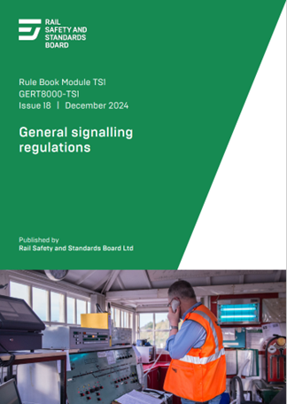
Changes to standards – September 2024
GERT8000-TS1 Issue 18 - General Signalling Regulations (1 of 2)
A new section has been included in this module to guide signallers on the actions they must take when advised that line-proving trains are to operate. Following the formalisation of the process in new standards, rules have
been placed into section 23 to give signallers a formal process for dealing with a line–proving train.
When personnel ask for trains to be stopped on a running line for their own protection, as described in section 13.1, the signaller has historically been required to complete a line blockage form (NR3180). Investigations into two 'near miss' incidents have questioned the appropriateness of using that form for this purpose, as it contains much detail that would not be relevant to this situation. A new simpler form (NR3178) has been introduced which contains only details relevant to this situation, which should reduce errors in compiling the form.
Rule Book module T10, Regulation 6 contains a requirement for the DP to arrange with the signaller to block an adjacent running line when work is to be carried out on the side of a vehicle nearest to that running line and the distance between the outside rail of the line on which the vehicle is standing and that adjacent running line is less than 3 metres (approximately 10 feet). (Continued on next slide.)
RU
IM
Suppliers
Click on the link icon to go to the standard

Slide 26
Changes to standards – September 2024
GERT8000-TS1 Issue 18 – General Signalling Regulations (2 of 2)
There is no corresponding instruction to signallers concerning this requirement, and to overcome this omission, a reference has been added in regulation 13.1.1 to this situation.
It has been pointed out that regulation 13.2.3 is not correct at present. The requirement to tell any other signaller should be to tell any other signaller who controls a portion of line within the line blockage. The term 'protecting signal or block marker' is used in regulation 13.2.3 in a way that is not consistent with how this is defined in regulation 13.2.2. Regulation 13.2.3 says that the signaller granting the line blockage must tell any crossing keepers who may be affected.
While this is correct so far as any crossing keeper within that signaller's area of control is concerned, it would be any other signaller controlling a portion of line within the line blockage who would tell any crossing keepers within that area of control. Regulation 13.2.3 has been reworded to correct these points.
As part of an intention to use new technology to better protect staff working on the railway, equipment has been the subject of successful trials which allows a COSS to disconnect signalling equipment remotely as a further means of providing additional protection for a line blockage. Regulations 13.2.4 and 13.2.7 have been changed to include this as a further permitted means of providing additional protection.
RU
IM
Suppliers
Click on the link icon to go to the standard

Slide 27
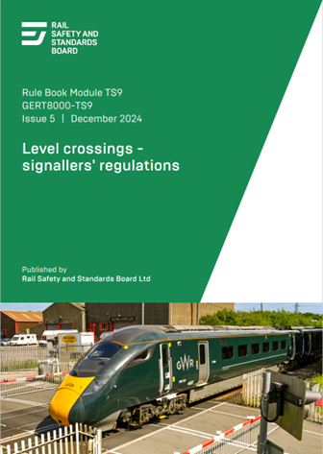
Changes to standards – September 2024
GERT8000-TS9 Issue 5 – Level crossings – signaller’s regulations (1 of 2)
It has been pointed out that while regulations 8.5.1 and 8.5.2 permit wrong-direction movements over an RC or CCTV level crossing supervised by a crossing keeper whether or not a level crossing attendant is on duty, regulation 8.8 requires an attendant to be appointed during single line working.
Regulation 6.9 allows an attendant not to be appointed at an RC or CCTV level crossing worked by a signaller, provided this is authorised in the Signal Box Special Instructions. It was found that it was intended to remove the exemption from both regulations on the basis that the inclusion in the Signal Box Special Instructions avoided the need for regulations.
However, although regulation 8 was changed, regulation 6 was not. There is an anomaly as a result. To overcome this, a reference to the exemption has been restored to regulation 8.8. (Continued on next slide.)
RU
IM
Suppliers
Click on the link icon to go to the standard

Slide 28
Changes to standards – September 2024
GERT8000-TS9 Issue 5 – Level crossings – signaller’s regulations (2 of 2)
Regulation 9 requires the driver of a wrong-direction movement that has started between the wrong-direction speed restriction board ('X' board) and a level crossing with red/green warning lights to approach the level crossing at caution and not pass over it unless it is safe to do so. These crossings in the past were provided at relatively infrequent intervals, but owing to the increased number of level crossings that have been equipped with overlay miniature stop lights in recent years, the relationship between an 'X' board and the level crossing to which it applies may not be apparent, and another level crossing of this type may intervene.
This is not necessarily an issue with a movement that passes through the whole section. But, to reduce the possibility of a train not approaching such a level crossing at caution, a new instruction has been introduced. It says that a train making a wrong-direction movement must proceed at caution until either the movement is completed, or the train passes an 'X' board.
The Rule Book has been reviewed to remove cases of gender-specific language which can be taken as an assumption that only males are involved. This may deter applications for employment or promotion. To overcome this changes have been made to remove any references to level crossings as being 'manned' and replace these with the term 'manually-controlled'. This change was previously published in the December 2022 Periodical Operating Notice.
RU
IM
Suppliers
Click on the link icon to go to the standard

Slide 29
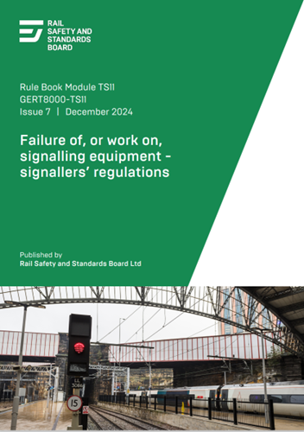
Changes to standards – September 2024
GERT8000-TS11 Issue 7 – Failure of, or work on, signalling equipment, signaller's regulations)
Regulation 10.1 allows a signaller to issue an on-sight (OS) movement authority (MA) when it is not possible to issue a full supervision (FS) MA. This is as an alternative to authorising a train to pass an end of authority (EoA) without an MA. The line is required to be clear as far as the overlap of the next EoA which is at a stop signal.
This was written to refer to an ERTMS line with lineside signals, and to allow the same to apply to an ERTMS line without lineside signals.
The wording has now been changed to refer also to a block marker.
RU
IM
Suppliers
Click on the link icon to go to the standard

Slide 30
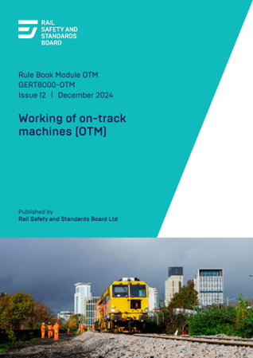
Changes to standards – September 2024
GERT8000-OTM Issue 12 – Working of on-track machines (OTM)
Section 10 of Handbook 15 Duties of the machine controller (MC) and on-track plant operator describes the arrangements that apply if any item of on-track plant (OTP) including any load, will foul an adjacent open line. This also applies to a line adjacent to any vehicles being loaded by the OTP with extendable equipment.
A similar situation can apply to cranes classed as on-track machines, and to ballast cleaners or regulators that are equipped with conveyors. Similar instructions have been introduced in this module.
Section 4.3 in this Handbook has been updated with the actual warning horn sound the competent person is expected to use when making a wrong-direction movement.
Enhanced briefing materials on the use of the horn can be found here https://www.rssb.co.uk/standards-catalogue/CatalogueItem/gert8000-tw1-iss-20
RU
IM
Suppliers
Click on the link icon to go to the standard

Slide 31
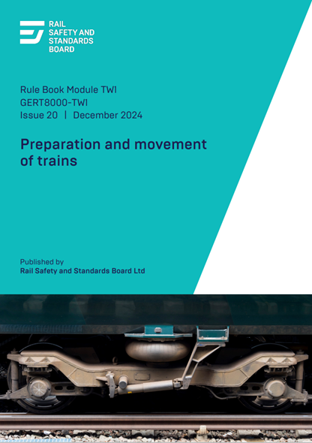
Changes to standards – September 2024
GERT8000-TW1 Issue 20 – Preparation and movement of trains (1 of 4)
A new section has been added to this module outlining the actions of drivers and signallers when told about the operation of a route-proving train. Following recommendations from the RAIB concerning the Carmont accident, a new standard (RIS-3771-TOM Issue 1 – Operation of Route- and Line-Proving Trains) has been created, designed to create a more standardised approach to route proving. As part of this project, rules for signallers and drivers have been developed. These rules include the actions that should be taken if members of staff have been provided to travel on the route-proving train to assist in the action of examination and inspection, or to assist in clearing debris on the track. As a result of this insertion, all sections after section 30 have now been renumbered.
The title of section 10.3 has been changed to say that this applies at a station where no platform starting signal is provided, to clarify its intended meaning. (Continued on next slide.)
RU
IM
Suppliers
Click on the link icon to go to the standard

Slide 32
Changes to standards – September 2024
GERT8000-TW1 Issue 20 – Preparation and movement of trains (2 of 4)
Section 14.4 requires an assisting train making a wrong-direction movement toward a failed train to display headlights at both ends. This was introduced following a case in which a driver was alarmed by sighting a tail lamp apparently ahead. The requirement appears to provide very little benefit as it does not apply to other wrong-direction movements where the same possibility would apply. It is also the case that some rolling stock cannot display headlights at both ends at the same time. The requirement has been removed, and the same requirements will apply as for any other wrong-direction movement.
An incident occurred in which a driver encountered what were 'reportable' rail adhesion conditions, but the full extent of the affected portion of line was not at first apparent. The rules have now been changed to include more guidance on what a driver should report to a signaller. In particular, a report should state the locations between which reportable conditions were encountered, so that the extent of the problem is better understood.
In another incident, a controlled test stop was arranged before the rail head had been treated, involving a portion of line where there is a reduction in permissible speed. The rule has been changed so that if the signaller is told about 'reportable’ conditions at a location where the driver would be reducing the speed of the train, the signaller must arrange for the drivers of subsequent trains to be told about the circumstances. A controlled test stop must not be arranged until after the rail head has been treated. (Continued on next slide.)
RU
IM
Suppliers
Click on the link icon to go to the standard

Slide 33
Changes to standards – September 2024
GERT8000-TW1 Issue 20 – Preparation and movement of trains (3 of 4)
The instructions concerning train radio equipment in section 41 have been updated to include the use of the different types of calls. This section now includes rules relating to the urgent call, the acknowledged safety broadcast call and the driver’s safety device (DSD) alarm call. These were originally in document RS523, which is an information handbook and cannot include instructions. The final removal of rules from RS523 is currently pending until the next phase of the work is complete.
The section on warning horns, section 48, has been updated. The changes aim to improve driver recall in high-stress situations and ensure a wider understanding of which warning horn sound is expected in each situation. Although the purpose of the horn is to provide a warning, different uses can assist in conveying different levels of urgency. The instructions have been simplified to refer to sounds rather than tones to make them easier to understand.
The title of section 48.2 has been changed to 'warning sounds to use' to better reflect the content and the instructions have been simplified throughout. The content of the main table now contains all scenarios in which the Rule Book requires the warning horn to be sounded, except for some degraded situations. This table is complemented by section 48.3. (Continued on next slide.)
RU
IM
Suppliers
Click on the link icon to go to the standard

Slide 34
Changes to standards – September 2024
GERT8000-TW1 Issue 20 – Preparation and movement of trains (4 of 4)
The instruction to frequently sound the horn in all wrong-direction movements was removed in issue three of GERT8000-TW7. There was no value identified for this instruction as no authorised safe systems of work for track workers depend on hearing an approaching train, and the frequent sounding of the horn would be no guarantee that anyone would hear it at the time. However, this rule remained in the table in TW1 and has now been removed. Sounding the horn continuously is not a mitigation measure specific to the type of movement. The driver would sound the horn if they saw someone on or near the line in accordance with the relevant instruction.
In alignment with the changes in section 48, the driver instructions in sections 26.4, 40, and 45 have also been expanded to include the actual sound to be used.
Enhanced briefing materials on the use of the horn can be found here https://www.rssb.co.uk/standards-catalogue/CatalogueItem/gert8000-tw1-iss-20
RU
IM
Suppliers
Click on the link icon to go to the standard

Slide 35
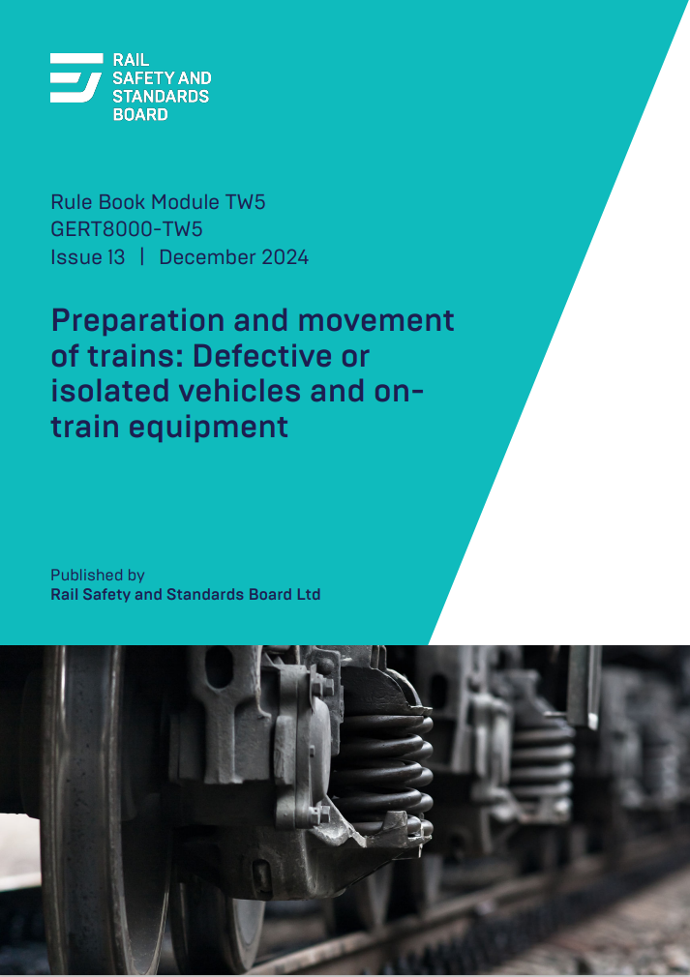
Changes to standards – September 2024
GERT8000-TW5 Issue 13 – Preparation and movement of trains: Defective or isolated vehicles and on-train equipment
The driver instructions in sections 9.2 and 14.3 have been amended to include the actual warning horn sound to be used, in alignment with section 48 of module TW1. Some wording has also been updated to improve clarity.
Enhanced briefing materials on the use of the horn can be found here https://www.rssb.co.uk/standards-catalogue/CatalogueItem/gert8000-tw1-iss-20
RU
IM
Suppliers
Click on the link icon to go to the standard

Slide 36
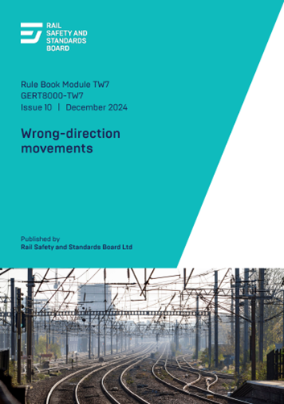
Changes to standards – September 2024
GERT8000-TW7 Issue 10 – Wrong-direction movements
After successful trials on various UK routes, new acceleration indicators have been introduced into the Rule Book. In line with the wording that has been introduced into other modules, TW7 was amended so that the wording regarding the application of trains accelerating when reaching a level crossing was extended to this module.
Section 4.2 states that unless a wrong-direction movement starts between the wrong-direction speed restriction board (X board) and a level crossing with red and green warning lights, it is not necessary to carry out the instructions concerning approaching the crossing at caution. These crossings were in the past provided at relatively infrequent intervals, but owing to the number of level crossings that have been provided with overlay miniature stop lights in recent years, the relationship between an 'X' board and the level crossing to which it applies may not be apparent and another level crossing of this type may intervene. This is not necessarily an issue with a movement that passes through the whole section, but to reduce the possibility of a train not approaching such a level crossing at caution, the rule has been changed. It now says a train making a wrong-direction movement must proceed at caution either until the movement has been completed, or until the train passes an 'X' board.
The driver instructions in section 4.2 have been amended to include the actual warning horn sound to be used, in alignment with section 48 of module TW1. Enhanced briefing materials on the use of the horn can be found here https://www.rssb.co.uk/standards-catalogue/CatalogueItem/gert8000-tw1-iss-20
RU
IM
Suppliers
Click on the link icon to go to the standard

Slide 37
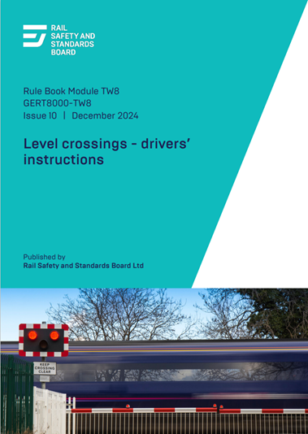
Changes to standards – September 2024
GERT8000-TW8 Issue 10 – Level crossings – drivers' instructions
The driver instructions in section 4.2 have been expanded to include the actual warning horn sound to be used in alignment with module TW1 section 48.
The Rule Book has been reviewed to remove cases of gender-specific language which can be taken as an
assumption that only males are involved. This may deter applications for employment or promotion. To overcome this, changes have been made to remove any references to level crossings as being 'manned' and replace these with the term 'manually-controlled. This change was previously published in the December 2022 Periodical Operating Notice.
Enhanced briefing materials on the use of the horn can be found here https://www.rssb.co.uk/standards-catalogue/CatalogueItem/gert8000-tw1-iss-20
RU
IM
Suppliers
Click on the link icon to go to the standard

Slide 38
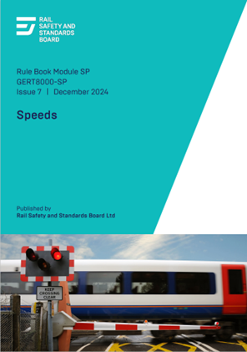
Changes to standards – September 2024
GERT8000-SP Issue 7 – Speeds
After successful trials on various UK routes, explanation and diagrams of the new acceleration indicators have been introduced into this module.
These signs, placed at the end of emergency and temporary speed restrictions,
inform drivers when they can accelerate their train back to the permissible speed
of the line when the front of the train reaches the board, and not when the whole
train has passed.
Applications for permanent speed restrictions have also been included.
All these applications relate to specific scenarios where the restrictions are
controlling collision risk, and not the risk of train derailment.
RU
IM
Suppliers
Click on the link icon to go to the standard

Slide 39
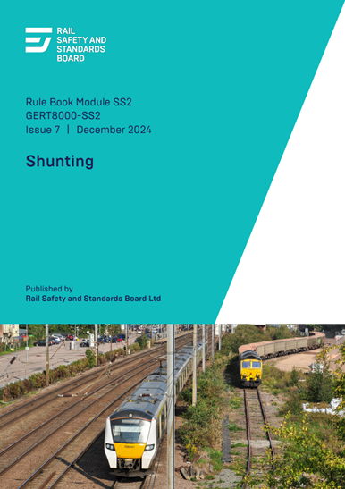
Changes to standards – September 2024
GERT8000-SS2 – Issue 7 – Shunting
Section 5.7 has been amended to include the actual warning horn sound to be used when entering a shed or building, in alignment with section 48 of TW1.
Enhanced briefing materials on the use of the horn can be found here https://www.rssb.co.uk/standards-catalogue/CatalogueItem/gert8000-tw1-iss-20
RU
IM
Suppliers
Click on the link icon to go to the standard

Slide 40
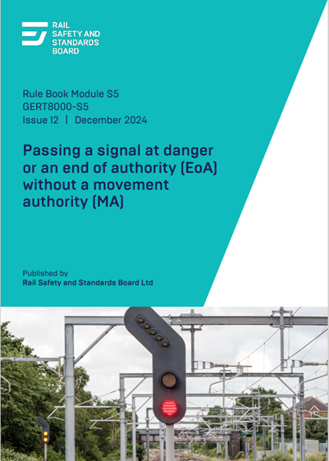
Changes to standards – September 2024
GERT8000-S5 Issue 12 – Passing a signal at danger or an end of authority (EoA) without a movement authority (MA)
Section 3.1 of this module requires a signaller on an ERTMS line who is authorising a driver to pass an end of authority (EoA) without a movement authority (MA) to tell the driver about any permissible speeds that are lower than the ceiling speed that applies to a movement in staff responsible mode. This is because those permissible speeds in that situation are not shown on the driver-machine interface (DMI). It has been pointed out that a signaller may not have a sufficient knowledge of permissible speeds to be able to do so. This section has been changed so that the signaller is only required to tell the driver about any temporary or emergency speed restrictions lower than the ceiling speed. These are not displayed on the DMI, but the signaller would be aware of them.
When section 4.5 was changed to refer to signals other than main aspect or stop signals up to which a driver might be given authority to pass a signal at danger, the same change in wording was not made in section 3.1 and this change has now been made.
RU
IM
Suppliers
Click on the link icon to go to the standard

Slide 41
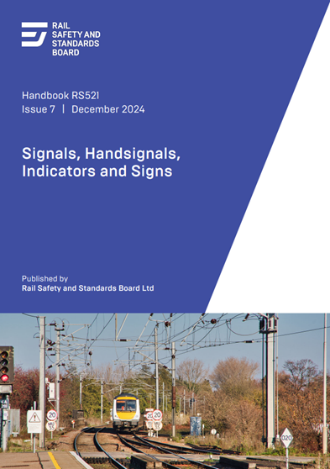
Changes to standards – September 2024
RS521 Issue 7 – Signals, Handsignals, Indicators and Signs Handbook
After successful trials on various UK routes, new acceleration indicators have been introduced into this module. These signs, placed at the end of emergency and temporary speed restrictions, inform drivers when they can accelerate their train back to the permissible speed of the line. Applications for permanent speed restrictions have also been included, where continuing at the reduced speed is unnecessary. Examples include level crossing sighting issues or collision risks at junctions, rather than controlling derailment risks.
The meaning of an 'Off' indicator on an ERTMS line is that the route has been set, and section 5.8 has been changed to include this explanation, in the interests of completeness.
RU
IM
Suppliers
Click on the link icon to go to the standard

Slide 42
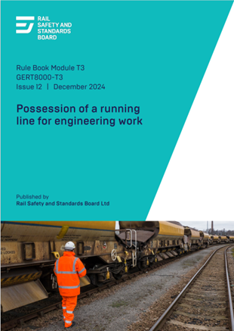
Changes to standards – September 2024
GERT8000-T3 Issue 12 – Possession of a running line for engineering work (1 of 3)
This module has been updated following the RAIB investigation into a 'near miss' with possession support staff. It relates to the arrangements for granting possessions in signal boxes and control centres with multiple workstations should be reviewed and where appropriate improved.
The Rule Book describes each possession as being of one line only, and any other signaller involved is assumed to be on the same line of route. Possessions are now frequently planned to cover extensive mileages on the same line of route, or to involve more than one line of route. Where more than one running line is involved, these may be published as a single item. Irregularities have arisen such as signallers not being aware that a possession has been granted, poor safety-critical communications and signallers being asked to grant permission for protection to be placed in areas they are not familiar with. It is also possible that a signaller may not be aware of the boundaries of other signalling control areas or the correct contact details when required to advise other signallers concerned. (Continued on next slide.)
RU
IM
Suppliers
Click the link icon to go to the standard

Slide 43
Changes to standards – September 2024
GERT8000-T3 Issue 12 – Possession of a running line for engineering work (2 of 3)
Successful trials have been carried out of an alternative arrangement. Under this, the person in charge of the possession (PICOP) contacts each signaller who has a protecting signal for the possession when a possession is being granted or given up. They then agree the arrangements so far as that signaller's area of control in concerned. Each of those signallers is responsible for advising adjacent signallers who do not have a protecting signal. These arrangements have now been included in the Rule Book.
When possession is taken around one or more engineering trains, the driver is instructed not to make any movement until instructed to do so by the PICOP or engineering supervisor (ES). There is no definite requirement to tell the driver that the possession has been granted. Drivers have been in doubt as to this or have misunderstood a preliminary conversation as meaning the possession has been granted. A requirement has been introduced for the PICOP or ES to tell the driver that the possession has been granted.
'Back-to-back' possessions are now permitted to be taken when the detonator protection has been placed in relation to points, providing no movements will take place from one possession into another. Clarification has also been included that the detonator protection for a 'back-to-back' possession can be at a 'sub-standard’ distance. (Continued on next slide.)
RU
IM
Suppliers
Click the link icon to go to the standard

Slide 44
Changes to standards – September 2024
GERT8000-T3 Issue 12 – Possession of a running line for engineering work (3 of 3)
For trains leaving a possession, the use of the heading 'Standard arrangement’ (in section 4.6 a) had been misinterpreted as meaning that this only applies when detonator protection is at the 'standard' distance. To avoid ambiguity this section has been retitled 'Normal arrangement'.
Following a recent incident in which an on-track machine entered a possession at an intermediate point without the necessary authority from the PICOP or signaller, it was agreed that the instructions to drivers on who can give that authority did not completely explain the procedure. The instructions to drivers have now been expanded so that they do reflect those that already existed for PICOPs and ESs.
These changes were previously published in the December 2023 Periodical Operating Notice.
Additional protection for a protection zone can now be provided by the use of engineering possession reminders (EPRs).
The competency of safe work leader (SWL) is no longer a recognised one and all reference to this obsolete competency has been removed.
RU
IM
Suppliers
Click the link icon to go to the standard

Slide 45
Changes to Standards – September 2024
Three non-RSSB standard has been published on the RSSB website.
COP0034 Issue 2 – Code of Practice for Piling using OTP
COP0035 Issue 3 – Code of Practice for Plant Modules on Rail Wagons and Trailers
COP0031 Issue 2 – Code of Practice for the Storage and Recommissioning of OTP
Click the link icon to go to the standard

Slide 46
Five deviations have been published since June 2024. (Slide 1 of 2)
23-025-DEV; GLRT1210 Issue 3 – AC Energy Subsystem and Interfaces to Rolling Stock Subsystem The use of the RFID Beacons on CVL Network instead of APC magnets at the six neutral sections in the three double track locations: Tonteg (CAM14.742km) and Radyr (CAM6.394km and RAD7.939km).
24-011-DEV; GERT8000-SP Issue 6 – Speeds
Within a protected path on the Up Trent Fast MainLine between RN3438 signal at Nuneaton station, and RN3360 signal on the approach to Rugby on the WestCoast Mainline.
24-019-DEV; GERT8000-HB11 Issue 10 – Duties of the person in charge of the possession (PICOP) Manchester Piccadilly station platforms 1 to12 inclusive.
24-007-DEV; GIRT7073 Issue 3 – Requirements for the Position of Infrastructure and for Defining and Maintaining Clearances. Huddersfield South Tunnel 25m0443y - 25m1137y Westgate Road Overbridge MVL3/90 - 25m1220y Leeds Road (A62) Overbridge MVL3/102- 28m49y.
24-014-DEV; GIRT7073 Issue 3 – Requirements for the Position of Infrastructure and for Defining and Maintaining Clearances. Purely at West Ealing platform 5, the site of the trial.
Click the link to access the deviation on the RSSB website

Slide 47
Draft standards scheduled for publishing in December 2024.
RIS-0793-CCS Issue 1 – Level Crossing System Integration
RIS-0792-CCS (Withdrawal) – Level Crossing Operational Interfaces with Trains
Train Driver Selection
RIS-3751-TOM Issue 4 - Psychometric assessment in train driver selection
Form F3751-F1 Issue 1 – Transfer of safety information Form
Form F3751-F2 Issue 1 – Audit Form for the Train Driver Psychometric Assessment Process

Slide 48
Draft standards scheduled for publishing in December 2024.
GEGN8646 Issue 1.1 – Guidance on the Common Safety Method for Risk Evaluation and Assessment
RIS-6702-DST Issue 1 – Common reference time for railway systems
RIS-2704-RST Issue 2 – Rail Industry Standard for Wheelsets Handling and Storage
RIS-2709-RST Issue 2 – Rail Industry Standard for the Identification of Roller Bearings Defects

Slide 49
Draft standards scheduled for consultation in September 2024.
Medical Fitness Requirements
RIS-3789-TOM Issue 1 – Medical Fitness Requirements
RIS-3451-TOM Issue 2 – (Withdrawn) Train Drivers Suitability and Medical Fitness Requirements​
RIS-3452-TOM Issue 2 – (Withdrawn) Train Movement Medical Fitness Requirements​
GOGN3655 Withdrawal – Guidance on Medical Fitness for Railway Safety Critical Workers

Slide 50
Draft standards scheduled for consultation in September 2024. (Continued)
Introducing special working to the Rule Book
GERT8000-HB5 Issue 3 – Handsignalling duties
GERT8000-M1 Issue 8 – Dealing with a train accident or train evacuation
GERT8000-M2 Issue 8 – Train stopped by train failure
GERT8000-S5 Issue 12 – Passing a signal at danger or an end of authority (EoA) without a movement authority (MA)

Slide 51
Draft standards scheduled for consultation in September 2024. (Continued)
Introducing special working to the Rule Book (continued)
GERT8000-TS2 Issue 7 – Track circuit block regulations
GERT8000-TW1 Issue 21 – Preparation and movement of trains
RS521 Issue 7 – Signals, Handsignals, Indicators and Signs Handbook
RS522 Issue 4 – AWS and TPWS Handbook

Slide 52
Draft standards scheduled for consultation in September 2024. (continued)
RIS-2700-RST Issue 3 – Rail Industry Standard for Verification of Conformity of Engineering Change to Rail Vehicles
RIS-2702-RST Issue 3 – In-service Examination and Reference Limits for Freight Wagons​​
GERT8073 Issue 5 – Application of Standard Vehicle Gauges
GMRT2173 Issue 5 – Size of Vehicles and Position of Equipment

Slide 53
Draft standards scheduled for consultation in January 2025.
GMGN2697 – Issue 1 – Guidance on Entity in Charge of Maintenance (ECM) Regulations
Draft standards scheduled for consultation in February 2025.
RIS-6701-DST Issue 1 – Unique Train Service Identifiers
RIS-2717-RST Issue 1 – Audibility of Rail Vehicles
RIS-2718-RST Issue 1 – Visibility of Rail Vehicles
GMRT2131 Issue 2 – Audibility and Visibility of Trains

Slide 54
Draft standards scheduled for consultation in March 2025.
Reducing the use of detonators
GERT8000-AC Issue 8 – AC Electrified Lines
GERT8000-DC Issue 6 – DC Electrified Lines
GERT8000-HB5 Issue 3 – Handsignalling duties
GERT8000-P1 Issue 9 – Single Line Working
GERT8000-P2 Issue 8 – Working single and bi-directional lines by pilot

Slide 55
Draft standards scheduled for consultation in March 2025. (Continued)
Reducing the use of detonators (continued)
GERT8000-TS2 Issue 6 – Track circuit block regulations
GERT8000-TS3 Issue 8 – Absolute block regulations
Defective on Train Equipment
GERT8000-TW5 Issue 13 – Preparation and movement of trains: Defective or isolated vehicles and on-train equipment
RIS-3437-TOM Issue 4 – Defective On-Train Equipment

Slide 56
Draft standards scheduled for consultation in March 2025. (Continued)
Review of AC and DC Rule book modules
GEGN8575 Issue 2 – Guidance Note on the Management of Electrical Risk Related to Operational Tasks on Electrified Lines
GERT8000-AC Issue 8 – AC Electrified Lines
GERT8000-DC Issue 6 – DC Electrified Lines
GERT8000-HB16 Issue 6 – AC Electrified Lines
GERT8000-HB17 Issue 5 – DC Electrified Lines

Slide 57
Draft standards scheduled for consultation in March 2025. (Continued)
GEGN8502 Issue 2 – Operation of Trams and Light Rail or Metro Vehicles Over GB Mainline Controlled Infrastructure
Speed restriction management
RIS-3772-TOM Issue 1 – Rail Industry Standard for speed restriction management
GERT8000-SP Issue 7 – Speeds

