Slide 1
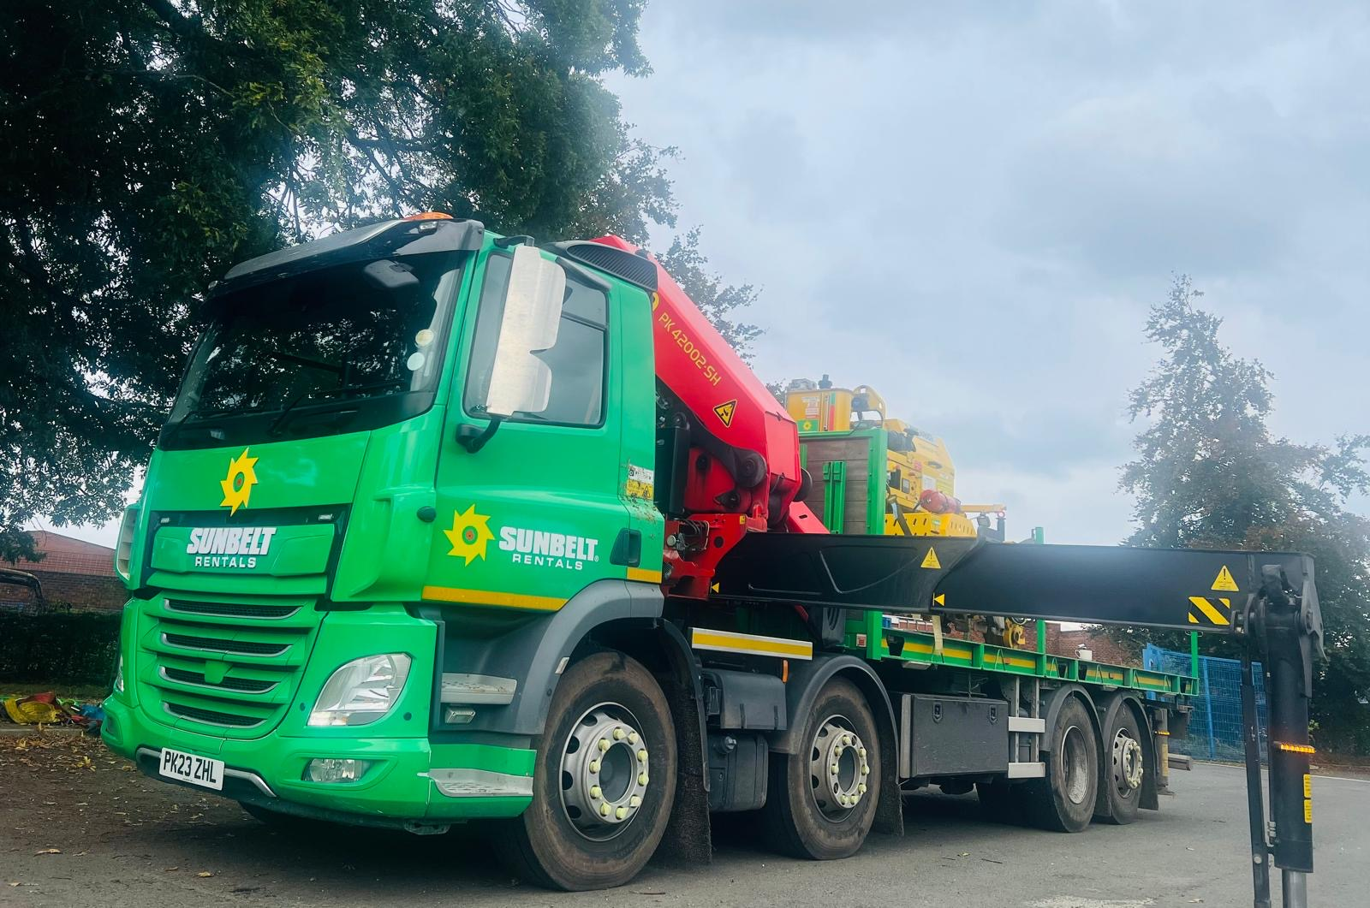

Rail business
Safety improvements on new Rail HGV Fleet

Slide 2
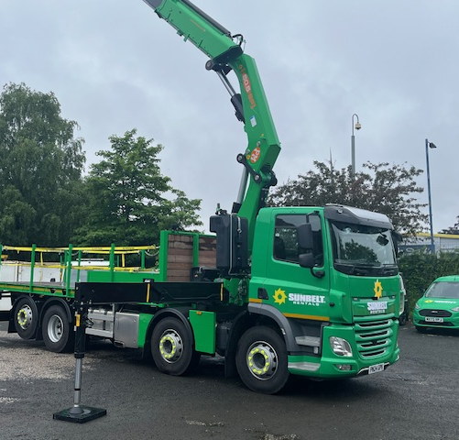
Background
Within Sunbelt rentals and the industry there are many different types of delivery vehicle for plant.
Historically, we have used multi-purpose vehicles with the ability to swap between depots so in peak times vehicles could be utilized where needed.
This involved a standard vehicle order so each Hiab HGV had a beavertail, winch, extending side steps so it could be used for wheeled plant which we have in other divisions if required.
We took the decision to come away from the norm and design a vehicle that was specific for our needs as a rail division.

Slide 3
Vehicle design brief
We set about with input from our own HGV drivers designing a vehicle that was suitable and safe for Rail equipment deliveries keeping in mind the type of equipment ranges from a battery light to a CD400 clipping machine. Also keeping in mind the unsociable times we deliver equipment. So, we had a brief
Suitable lighting for night-time deliveries
Access to bed both side front and rear for when the load takes up the width of the bed
Fall arrest protection all around
Ensuring different types of load can be safely secured to the bed
Lifting capability for loading and unloading to cater for longer reach in restricted and obstructed sites
Lighting to alert others in the vicinity for visibility of operations
Accessible and sufficient storage for strapping and lifting equipment

Slide 4
Vehicle Design Output
Following extensive consultation with our staff and vehicle supplier, the final vehicle design incorporated the following improvements adding both to safety and capability for our logistics operations:
360 degree lighting bed and from chassis down to the floor to highlight poor ground conditions
Pull out ladders in 4 x points around the bed, mid vehicle bed and end of vehicle bed to allow access and egress
Fall arrest system all the way around the vehicle bed previously we had beavertails on the vehicles so the rear of the bed had no protection against falls from the vehicle bed
cabin locks spaced for 10ft stores historically placed for 20ft stores (only allowing front or rear locks to be applied)
Rails installed into bed before wooden deck being installed to allow equipment to be fully on rail wheel surface instead of rail wheel flange
Removable sides fitted to make enclosed bed for carrying smaller items, this is fully removable to allow access to full bed for larger loads
Larger Crane fitted to vehicle to reduce failed collections when wacker plates etc are left in a position where it is not possible to get the vehicle at the side of them (RRV blocking access etc)
LED roof beacons and 2 x single LED beacons front and rear to provide awareness of operations
Large storage box and on bed storage to protect lifting equipment and strapping equipment from the elements

Slide 5
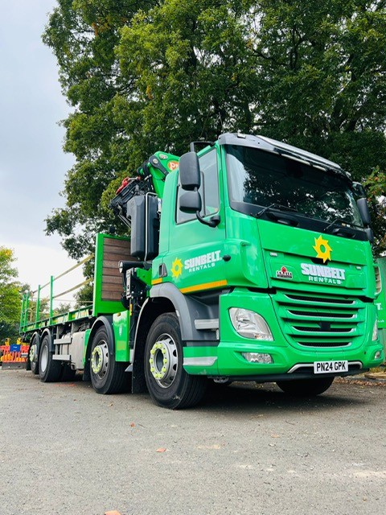
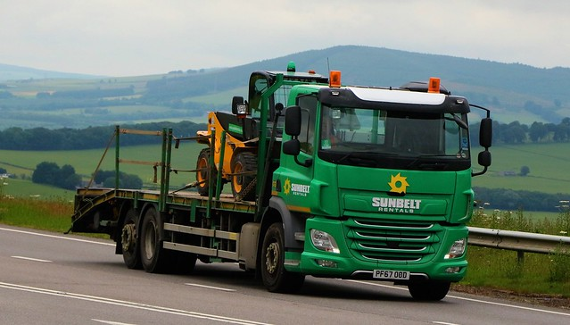
Standard HGV vehicle and our new HGV Rail vehicle
Before and after pictures of the beaver tail and the new HGV

Slide 6
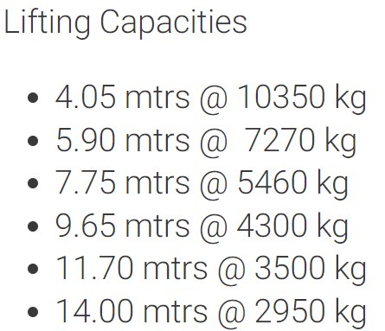

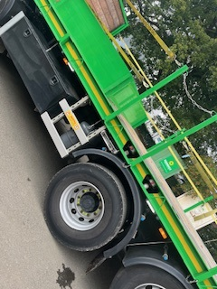
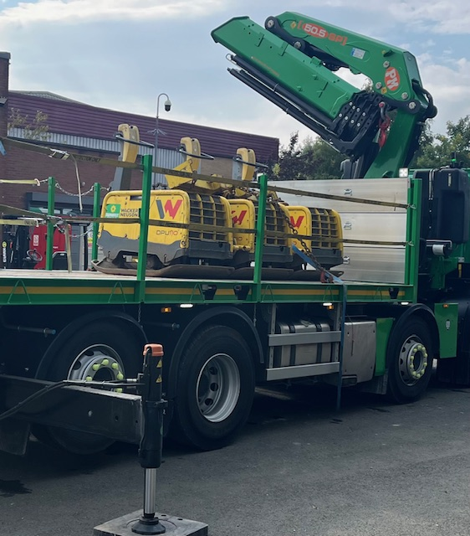
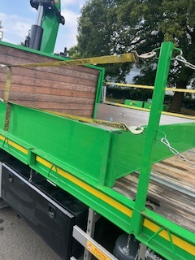
Features of the Rail HGV Vehicle
PM 50.5 SP crane
Cabin Locks Positioned for 2 x 10fts stores
Removable Enclosed Bed For Carrying Smaller Items Safely
Bed Fully Open Sides Stored On Headboard
Enclosed Bed Deployed

Slide 7
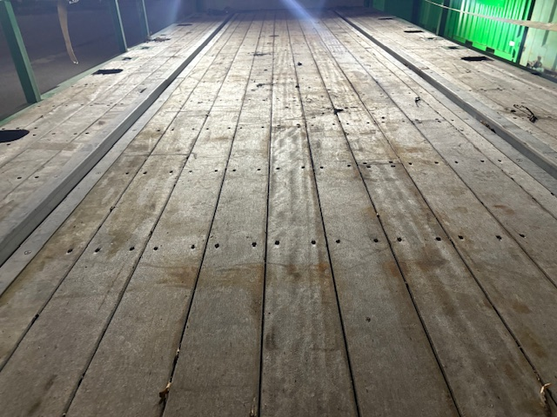
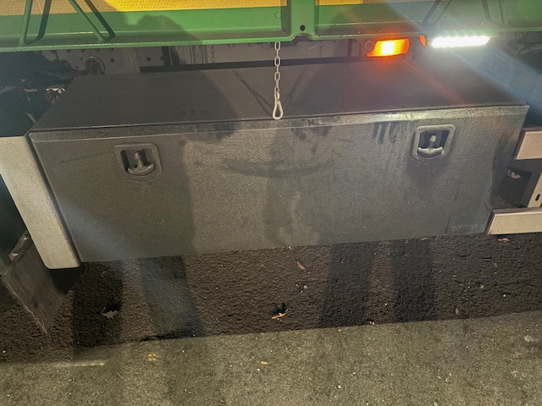
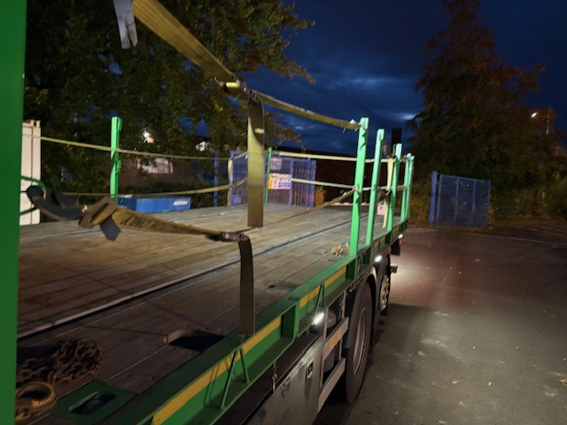
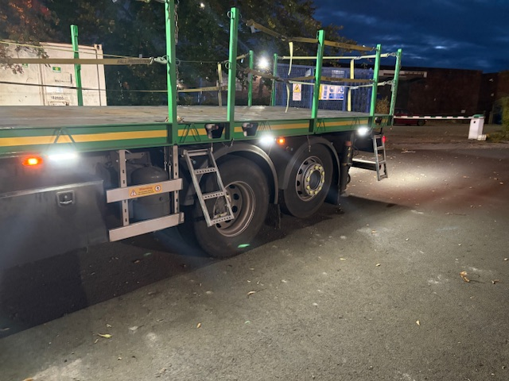
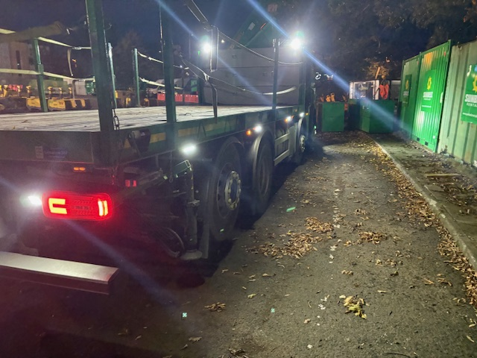
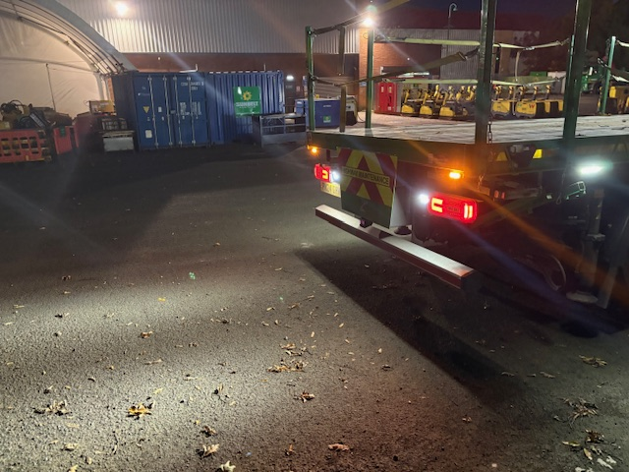
Set Rail In Bed for Rail Wheels
Large Storage Box
Fall Protection All Around
Pull Out Access Ladders
All around Lighting
All around Beacons For Visibility

Slide 8
Summary Of Improvements
After Consultation from the drivers the below are some of the benefits that are already assisting the drivers carry out their duties to a safe standard.
Loads more easily anchored and secured to the load bed
Improved lighting and visibility of the load bed and around the vehicle
Improved access and egress to the load bed with improved fall protection
Improved crane reach for loading and unloading
All the above make for safer and more efficient delivery of plant and materials.

Slide 9
Adam Hartley

